Slide 1
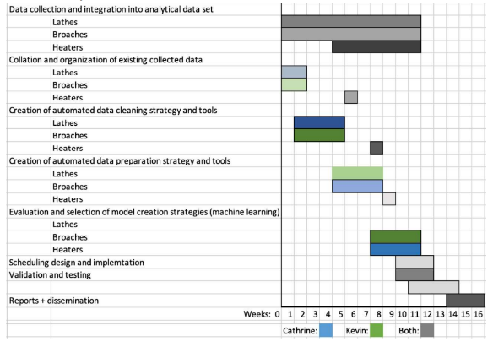
Innovation Hub – Your Name
Findings: On broaching: Pressure is ‘zeroed’ after a new tool is installed | Needs/requests Why is the position value always zero? What happened on January 28th?
Status/Timing Data cleansing complete Data collation continues On track to finish next week | Other The sky is blue

